Slide 1
2.2. Large Language Model (LLM)

Slide 2
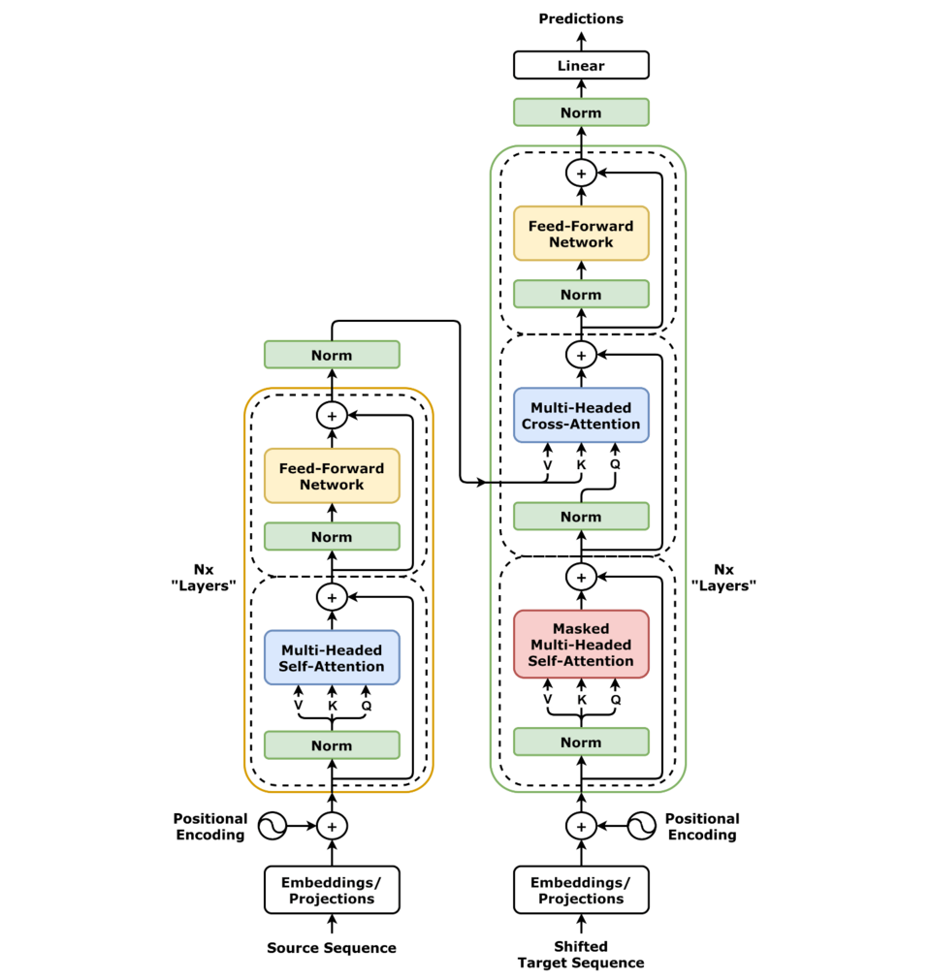








Introduction to LLMs
A Large Language Model (LLM) is a type of AI model trained to understand and generate human-like text.
GPT-5
Chatbots
Gemini 2.5
Doc QA
Llama 4
Coding
DeepSeek
Agents
Transformer Architecture
Popular LLMs
Applications

Slide 3
What makes it “Large”?
175B
Parameters
Scale & Complexity
GPT-3 has 175 billion parameters, while newer models like GPT-4 & GPT-5 likely exceed this. More parameters enable better understanding but require significantly more computational resources.

Slide 4
The LLM Workflow
Input Text
1
Raw text enters the system for processing
Tokenization
2
Text converted to numerical tokens
Neural Network
3
Transformer processes token relationships
Output Tokens
4
Model predicts next token sequences
Output Text
5
Tokens converted back to readable text

Slide 5
Tokenization
Tokenization Process
Example
Tokenization breaks text into smaller units like words, subwords, or characters. This allows LLMs to process language efficiently by converting these units into numeric IDs, enabling better generalization and reduced vocabulary size.
The sentence “ChatGPT is amazing!” becomes
["Chat", "G", "PT", " is", " amazing", "!"]
via subword tokenization, showing how even complex or unfamiliar words are broken into meaningful parts.
Splits text into smaller semantic chunks
Converts tokens into numerical IDs
Enables processing of unseen words
"Chat" stays as "Chat"
"GPT" splits into "G" and "PT"
Semantic meaning is preserved through subword units
Note: Actual token splits may vary depending on the model and tokenizer used (e.g., GPT-2, GPT-4, LLaMA, etc.)

Slide 6


Proprietary vs Open-Source LLMs
Proprietary LLMs
OpenAI - GPT-3, GPT-4, GPT-5, GPT-o4
Google - Gemini-2.5
Anthropic - Claude Opus 4.1, Claude Sonnet 4
Open-Source LLMs
Meta - Llama-2, Llama-3
Google - Gemma-2, Gemma-3
OpenAI - GPT-oss
DeepSeek

